Slide 1



Evaluating Optimal States for Health Tracker Smartwatch Business Expansion
By: Jiggy Boy G. Romo
The objective of this project is to meticulously identify and evaluate the state(s) within the United States that offer the greatest potential for the successful expansion of our health tracker smartwatch line.

Slide 2
Project description
The objective of this analysis is to identify and recommend the state(s) within the United States that hold the most favorable condition for the successful expansion of our health tracker smartwatch business by determining the following:
Percentage of income by state and corruption conviction if there any observable connection.
Identify the states with the highest and lowest average income.
Identify the states with the highest and lowest corruption conviction rates.
Test the correlation between state income and corruption convictions.

Slide 3
Postgres
Top 5 States with Highest Average Income
Top 5 States with Lowest Corruption Rate
State | Average Income
Maryland | $ 89,392.00
Massachusetts | $ 82,427.00
New Jersey | $ 81,740.00
California | $ 80,440.00
Connecticut | $ 79,287.00
Short conclusion:
We found out that these 5 states with the lowest corruption rate(measured on a scale 0 to 10).
This leads to the conclusion that these states have been relatively successful in maintaining low level of corruption.
Additionally, our analysis revealed that the top 5 states with the highest average incomes, showcasing a clear connection between economic prosperity and corruption prevention.
State | Corruption Conviction
Hawaii | 0.43
Vermont | 0.44
Maine | 0.48
New Hampshire | 0.51
Nebraska | 0.57

Slide 4
Excel
Short conclusion:
Based on the results, it can be observed that states with higher average incomes tend to have lower corruption rates. On the other hand, states with lower average incomes have higher corruption rates. This suggests a correlation between economic prosperity and reduced corruption at the state level.

Slide 5
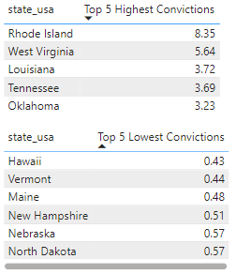
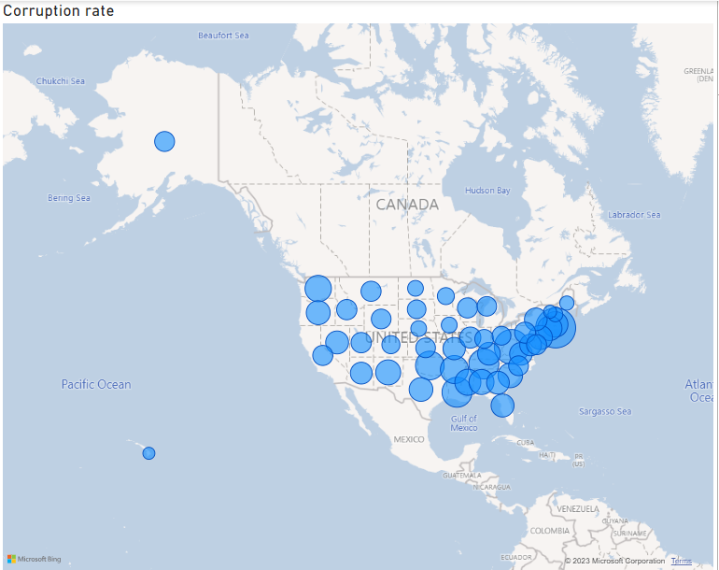
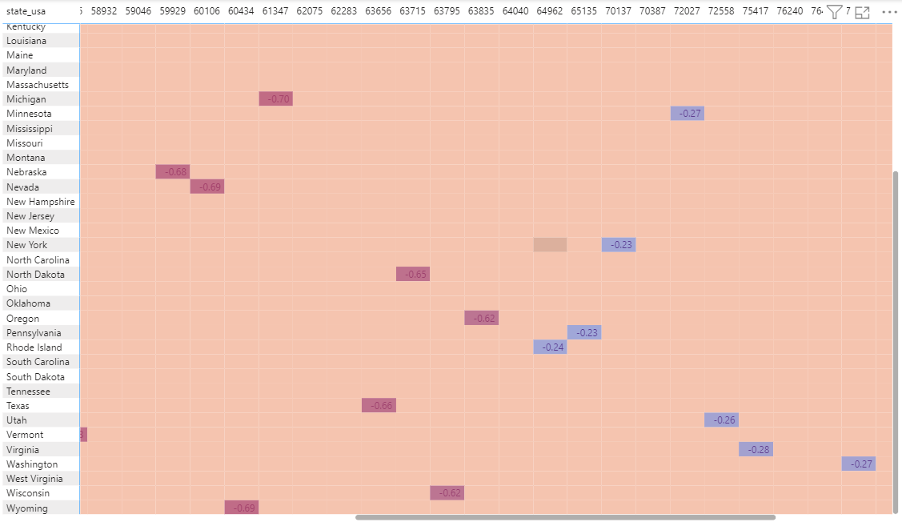
Power BI
Short conclusion:
The correlation matrix suggests that there is a slight negative correlation between income and the rate of convictions.
As income levels increase on the dashboard, there is a tendency for the convictions rate to decrease.

Slide 6
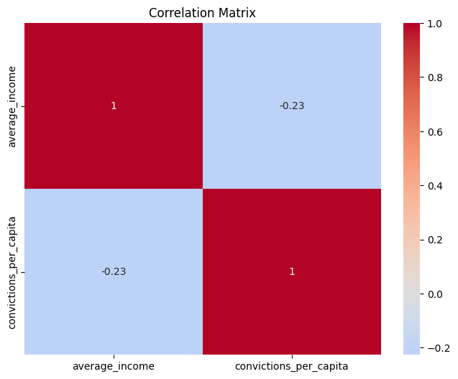
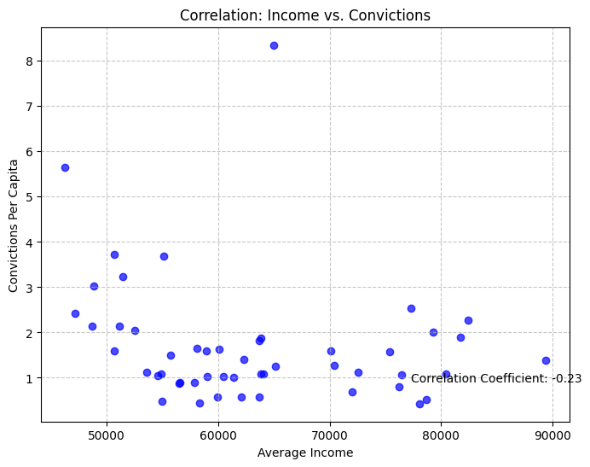
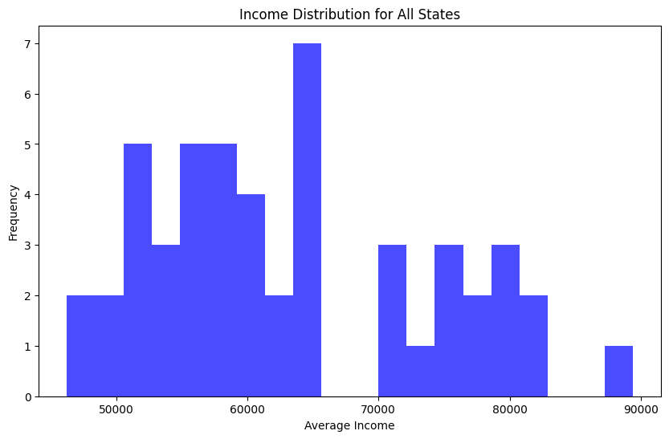
Python
Short conclusion:
A correlation coefficient of -0.23 indicates a weak negative correlation between ‘average income’ and ‘convictions’.
The histogram graph displayed a positive skewness, indicating that the majority of states possess lower average incomes while a minority of states exhibit considerably higher average incomes.

Slide 7
Conclusion
Summary of Findings
In this analysis, an exploration of the data highlights a mild negative correlation between income and convictions rate. This suggests that as income levels increase, there is a tendency for the convictions rate to decrease, though not very strongly.

Slide 8
Conclusion
Insights
This analysis suggests that states with higher income levels are less likely to have higher conviction rates. This phenomenon may be attributed to the abundant resources available in these prosperous states, enabling individuals to access better legal representation and support, which in turn reduces the likelihood of convictions. Furthermore, it hints at a distinctive cultural behavior prevailing in affluent states, where a strong aversion to criminal activities is ingrained in the societal fabric. Additionally, the presence of stringent government policies targeting corruption may loom large in these regions, instilling a palpable fear among individuals contemplating corrupt actions. As a result, the combination of resource abundance, cultural values, and strict anti-corruption measures converges to create a deterrent effect on criminal behavior, ultimately leading to lower conviction rates in high-income states."

Slide 9
Conclusion
Answers to Business Questions
Conclusion in Relation to Business Expansion:
Expanding into states with lower conviction rates, particularly high-income states, may offer a more favorable business environment, with potentially reduced legal and ethical risks. This can foster greater confidence in concluding business operations while maintaining a positive reputation.
However, it’s vital to acknowledge that selecting a state for business expansion is a complex decision. Other critical factors, such as tax rates, labor costs, and market demand, should also be carefully evaluated.

Slide 10
Conclusion
Recommendations
Evaluate Conviction Rates: Consider the conviction rates in potential expansion states, especially focusing on high-income states. States with lower conviction rates may offer a more favorable business environment, with potentially lower legal and ethical risks.
Comprehensive Analysis: While conviction rates are important, conduct a comprehensive analysis that include factors like tax rates, labor costs, market demands, and regulatory environment. This holistic approach will help you make a well- rounded decision.
Government Engagement: Engage with local government authorities to understand their policies and initiatives that may impact your business. Build positive relationship with regulatory bodies.

Slide 11
Conclusion
Challenges Encountered During the Analysis
The challenges encountered during the analysis revolved around the limited dataset size and the exploration of the relationship between state income and state convictions. These constraints in data size posed difficulties in achieving statistical significance and comprehensive insights. Additionally, while investigating the connection between state income and state convictions, it became evident that the complex dynamics involved in this relationship required more extensive data and possibly supplementary variables to yield a deeper understanding.

Slide 12
Conclusion
Recommendations for Future Research
Expand Data Collection: To enhance the depth and breath of analysis, future research should aim to collect more comprehensive data. This might includes gathering additional variables related to law enforcement practices, socioeconomic factors, and cultural indicators within each states.
Comparative Analysis: Extend the analysis to include a comparative study of different regions or countries to identify global trends and regional variations in the relationship between income and convictions.
Longitudinal Analysis: Conducting longitudinal analysis over several years can provide insights into trends and changes in the relationship between state income and state convictions. This can help uncover evolving patterns and potential causal factors.

